Slide 1
Bottom-Up Abstractive Summarization
ADVISOR: JIA-LING, KOH
SOURCE: EMNLP ’18
SPEAKER: kuan-yu, sheng
DATE: 2020/10/27

Slide 2
Outline
Introduction
Method
Experiment
Conclusion

Slide 3
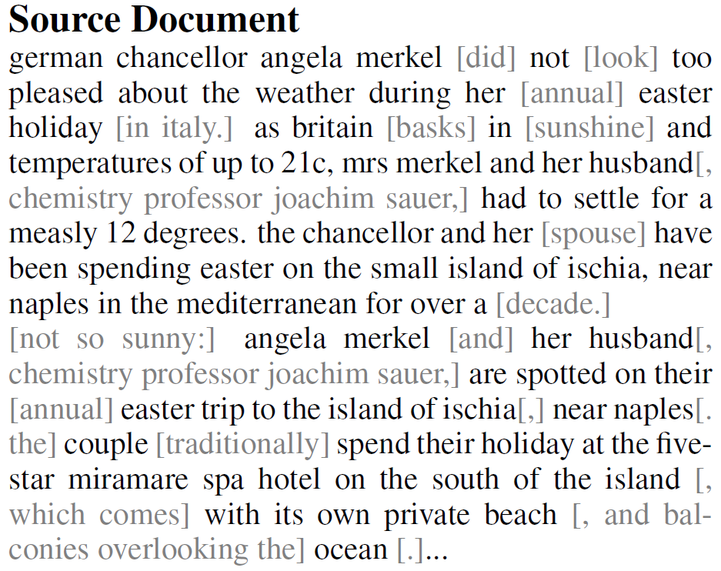
Introduction
3
Goal

Slide 4
Introduction
4
Approaches
2015
2017
2018
Pointing the Unknown Words
Get To The Point: Summarization with Pointer-Generator Networks
Bottom-Up Abstractive Summarization
Pointer-Generator Network
Generate (abstract)
Copy (extract)
Pointer-Generator Network
Generate (abstract)
Copy (extract)
Coverage mechanism
Pointer-Generator Network
Generate (abstract)
Copy (extract)+Bottom-up
Length penalty
Repeat penalty

Slide 5
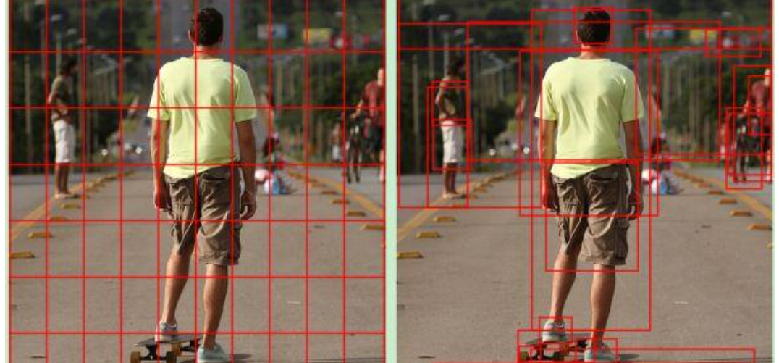
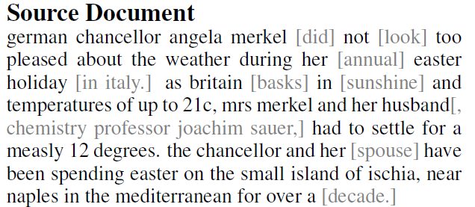
Introduction
5
Approaches – Bottom-up
Bottom-up attention concept in CV
Pointer-Generator Network
Generate (abstract)
Copy (extract)+Bottom-up
In text

Slide 6
Introduction
6
Approaches – Bottom-up
Pointer-Generator Network
Generate (abstract)
Copy (extract)+Bottom-up
V.S.
Improvement:
No longer prefer to copy a long sequence from the source document.
Notes:
4.2有提到

Slide 7
Outline
Introduction
Method
Experiment
Conclusion

Slide 8
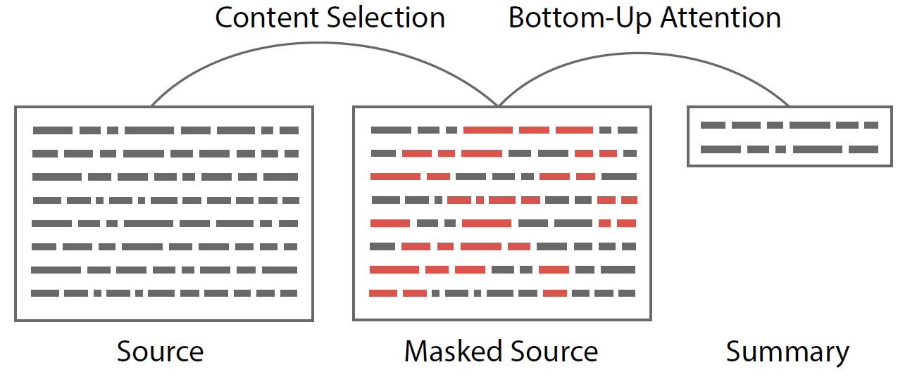
Method
Problem Define
Sequence tagging problem
Generation problem
Notes:
A1再圖4有
A1 = 3
A2 = 24

Slide 9
Method
Sequence tagging problem
Problem define :
Document = $t_{1}$ , $t_{2}$ , $t_{3}$ … $t_{n}$ .
$t_{i}$denote binary tags , 1 is copied and 0 otherwise.
Training :
Input word embedding $w_{i}$ = $e_{ i}^{(w)}$ + $e_{ i}^{(c)}$
$e_{ i}^{(w)}$ : pre-train word embedding
$e_{ i}^{(c)}$ : pre-train contextual embedding (ELMo)
Notes:
A1再圖4有
A1 = 3
A2 = 24

Slide 10
Method
Sequence tagging problem – contextual vector
ELMo (Embeddings from Language Models):
Contextual level V.S. word level
Have you paid that money to the bank yet ?
It is safest to deposit your money in the bank .
The victim was found lying dead on the river bank .
They stood on the river bank to fish.
Notes:
A1再圖4有
A1 = 3
A2 = 24

Slide 11
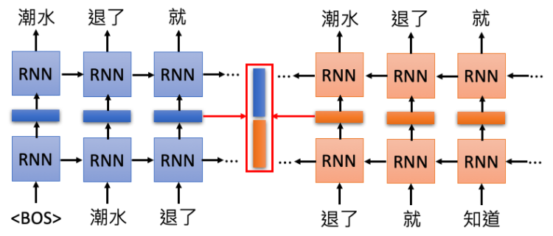
Method
Sequence tagging problem – contextual vector
ELMo (Embeddings from Language Models):
Example : “潮水 退了 就 知道 誰 沒穿 褲子”
Notes:
A1再圖4有
A1 = 3
A2 = 24

Slide 12
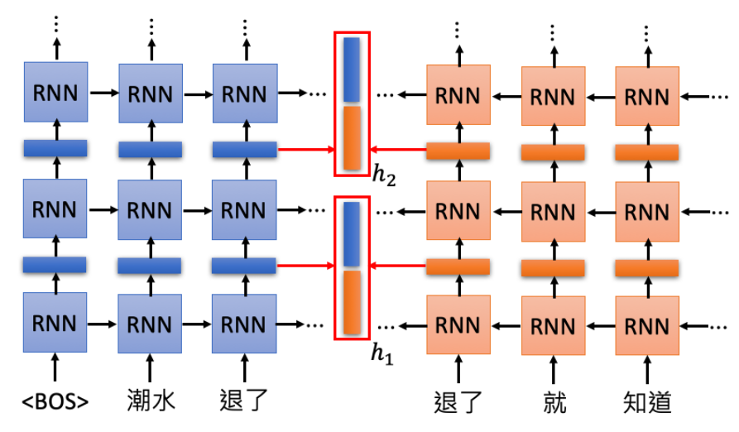
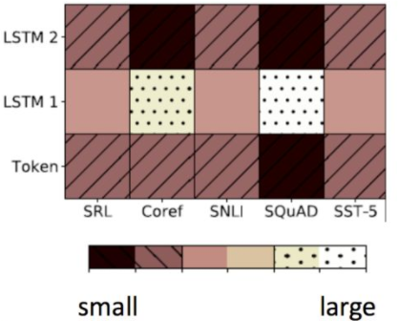
Method
Sequence tagging problem – contextual vector
ELMo (Embeddings from Language Models):
Example : “潮水 退了 就 知道 誰 沒穿 褲子”
Trainable parameters
Notes:
A1再圖4有
A1 = 3
A2 = 24

Slide 13
Method
Sequence tagging problem
Sequence tagging stack :
Input sequence { ${token}_{1}$ , ${token}_{2}$ , ${token}_{3}$ … ${token}_{n}$ }
Label vector of ${ token}_{1}$
Label vector of ${ token}_{2}$
Label vector of ${ token}_{n}$
LSTM Unit
LSTM Unit
LSTM Unit
$h_{0}$
……
$e_{ 1}^{(w)}$ + $e_{ 1}^{(c)}$
$e_{ 2}^{(w)}$ + $e_{ 2}^{(c)}$
$e_{ n}^{(w)}$ + $e_{ n}^{(c)}$
$${token}_{1}$$
$${token}_{2}$$
$${token}_{n}$$
Notes:
A1再圖4有
A1 = 3
A2 = 24

Slide 14
Method
Generation problem - Basic Seq2Seq model
Encoder:
$$x_{1}$$
$$x_{2}$$
$$x_{3}$$
$$x_{T}$$
LSTM
LSTM
LSTM
LSTM
$$h_{1}$$
……
$$h_{2}$$
$$h_{3}$$
$$h_{T}$$
We get : $h_{1}$ , $h_{2}$ , $h_{3}$ … $h_{T}$
LSTM
LSTM
LSTM
LSTM
$$x_{1}$$
$$x_{2}$$
$$x_{3}$$
$$x_{T}$$

Slide 15
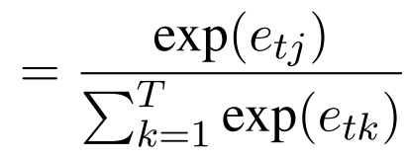
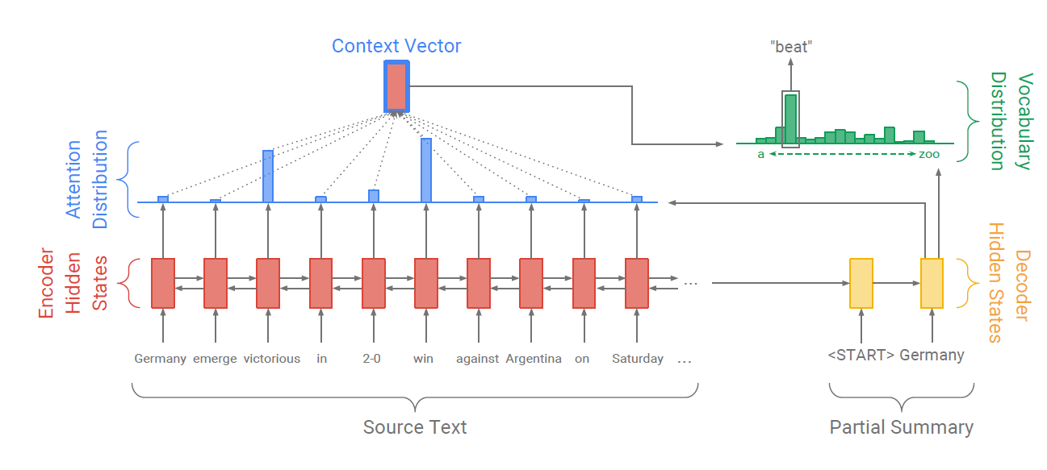
Method
Generation problem - Basic Seq2Seq model
Decoder :
$$S_{1}$$
$$S_{2}$$
$$S_{n}$$
Encoder output : $h_{1}$ , $h_{2}$ , $h_{3}$ … $h_{T}$
$$S_{3}$$
Key
GRU
GRU
GRU
GRU
Query
$$e_{ i}^{t}$$
$$a_{i}^{t}$$
$$x_{0}$$
$$x_{1}$$
$$x_{2}$$
$$x_{n−1}$$
$$e_{ k}^{t}$$
Value

Slide 16
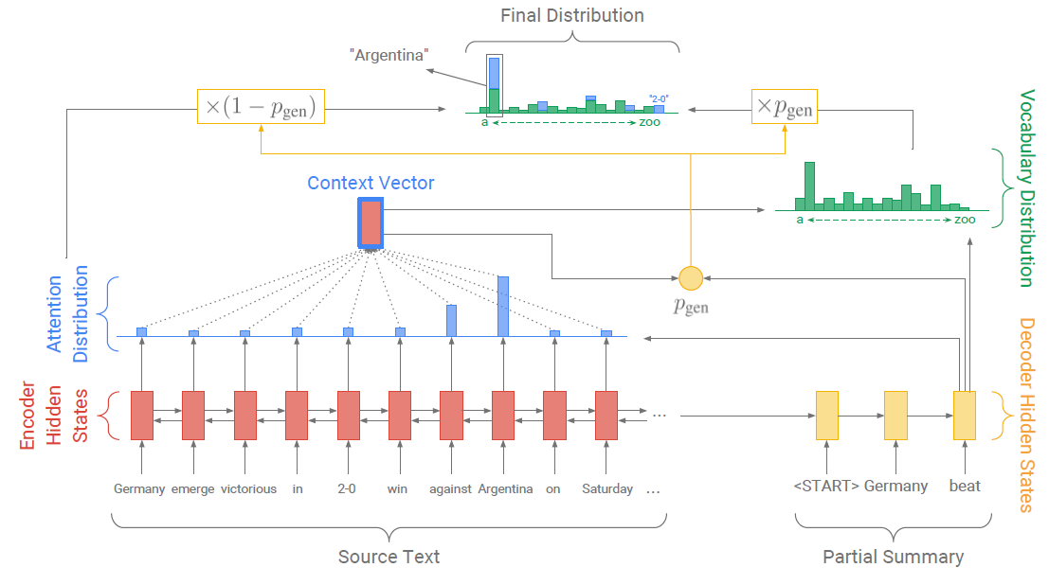
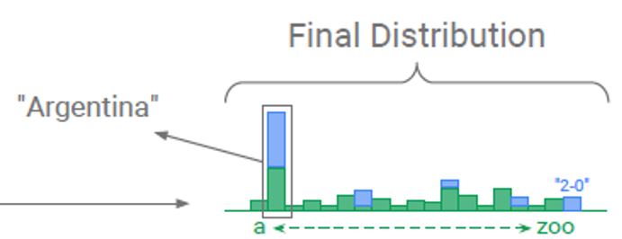
Method
Generation problem – pointer-generator network
Decoder output
Encoder output (after attention)
Decoder input

Slide 17
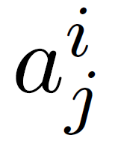
Method
Bottom-up copy Attention
Notation :
Selection probability sequence : $q_{1}$ , $q_{2}$ , $q_{3}$ … $q_{n}$
attention decode at step j to encode word i :
attention distribution for a decoding step j :
Given a threshold , the selection is applied as a hard mask, such as :
After that , we will normalize the distribution as the new copy probabilities.

Slide 18
Method
Generation problem – 2 penalties
Notation :
Source token : $x_{1}$ , $x_{2}$ , $x_{3}$ … $x_{n}$
Summary : $y_{1}$ , $y_{2}$ , $y_{3}$ … $y_{m}$
attention decode at step j to encode word i : (P.15)
Length penalty :
Copy penalty :
Scoring Function :
Higher a is , longer the summaries are .

Slide 19
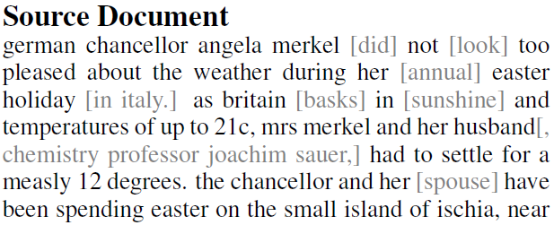
Method
Example

Slide 20
Outline
Introduction
Method
Experiment
Conclusion

Slide 21
EXPERIMENT
21
Data set
CNN/DM:
93k articles form CNN(with summary).
220k articles form Daily Mail(with summary).
New York Times Annotated Corpus :
Contains over 1.8 million articles written and published by the New York Times between 1987/1/1 ~ 2007/6/19.
The corpus includes Over 1.8 million articles.
Over 650,000 article summaries written by library scientists.
Notes:
CNN/DM:
NYC : 他的summary有時並不是句子，而且十分零碎，較不適合這項模型的設計。

Slide 22
EXPERIMENT
22
Result on CNN/DM
Notes:
黃色 : 能夠看出改成transformer幫助不大
綠色:
Mask only : training時有mask，但testing時沒有mask
Multi-task : 驗證selector是否可以與Abstractive generator系統一起訓練。視為multi-task problem。Abstractive generator以及selector共享編碼器，test有mask.
Diff-Mask : 一個完整end to end模型，完全可微。
結論 : Mask機制需要在test時用，而且不能將selector與generator一起訓練(成果不好)。
藍色 : 效果極好

Slide 23
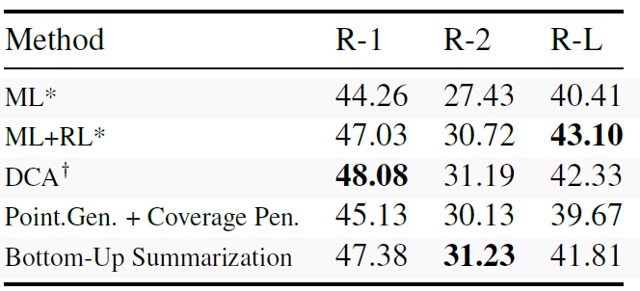
EXPERIMENT
23
Result on CNN/DM
Results on the NYT corpus, where we compare to RL trained models. * marks models and results by Paulus et al. (2017), and results by Celikyilmaz et al. (2018).
Notes:
作者認為可能是參數選擇導致其結果不比其他人好，但他無法確認。
而且這模型本來就不是針對於NYC的資料集設計，不向上述其他模型，但仍然十分有比較性。

Slide 24
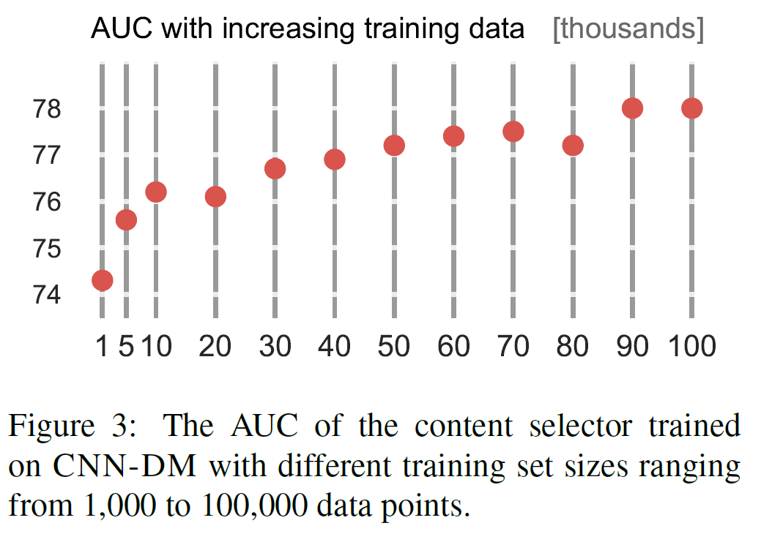
EXPERIMENT
24
content selector

Slide 25
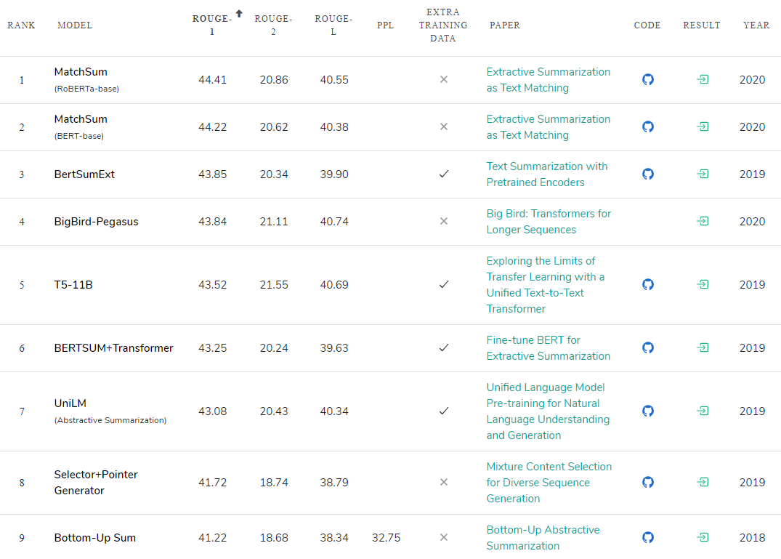
EXPERIMENT
Rank on CNN/DM data set

Slide 26
Conclusion
This work presents a simple but accurate content selection model for summarization that identifies phrases within a document that are likely included in its summary.
We showed that this content selector can be used for a bottom-up attention that restricts the ability of abstractive summarizers to copy words from the source.
Preliminary work that investigates similar bottom-up approaches in other domains that require a content selection, such as grammar correction, or data-to-text generation, have shown some promise and will be investigated in future work.

